Slide 1
AIR COMPRESSORS

Slide 2
Introduction
A gas compressor is a mechanical device that increases the pressure of a gas by reducing its volume. Compressors are work absorbing devices which are used for increasing pressure of fluid at the expense or work done on fluid.
The compressors used for compressing air are called Air compressors. Work required for increasing pressure of air is available from the prime mover driving the compressor.
Generally, electric motor, internal combustion engine or steam engine, turbine etc. are used as prime movers. Compressors are similar to fans and blowers but differ in terms of pressure ratios. Compressors are similar to pumps: both increase the pressure on a fluid and both can transport the fluid through a pipe.

Slide 3
Compressed air
Compressed air is air which is kept under a certain pressure, usually greater than that of the atmosphere.
Compressed air can be used in or for:
pneumatics, the use of pressurized gases to do work.
vehicular transportation using a compressed air vehicle
gas dusters for cleaning electronic components that cannot be cleaned with water.
railway braking systems
road vehicle braking systems
air tools

Slide 4
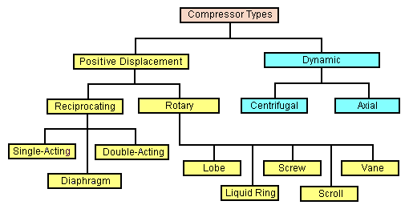
Types of compressors

Slide 5
Compressors can be classified in the following different ways:
(a)Based on principle of operation:
Based on the principle of operation compressors can be classified as.
Positive displacement compressor.
Non-positive displacement compressors.
In positive displacement compressors the compression is realized by displacement of solid boundary and preventing fluid by solid boundary from flowing back in the direction of pressure gradient.
Due to solid wall displacement these are capable of providing quite large pressure ratios. Positive displacement compressors can be further classified based on the type of mechanism used for compression. These can be:
Reciprocating type positive displacement compressors
Rotary type positive displacement compressors.

Slide 6
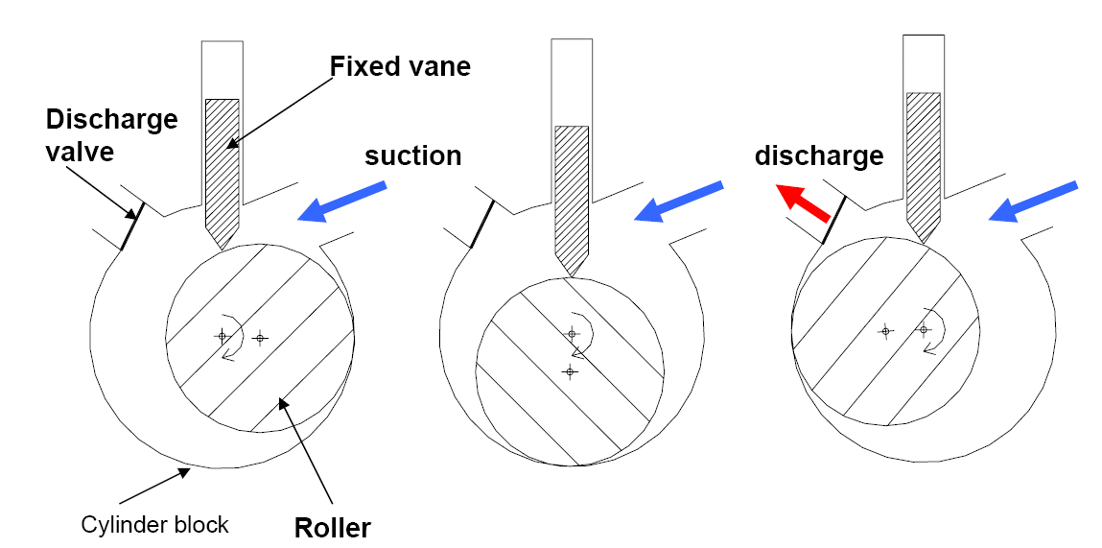
Positive Displacement type Compressor

Slide 7
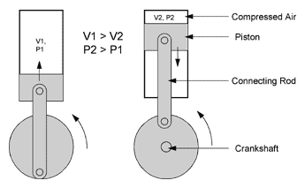
Reciprocating Compressor Schematic
Positive Displacement type Compressor

Slide 8
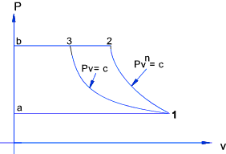
Reciprocating compressors are often used with air reservoirs to provide compressed air for industrial and civil duties driving air tools etc. Reservoirs have to be used because reciprocating compressors provide a pulsating air delivery. The figure below shows a hypothetical indicator diagram for a single stage -single acting reciprocating compressor.
a ->1... Air is drawn into the cylinder on the suction stroke
1 ->2... The suction valve is closed and air is compressed according to the law Pv^{n} = c
2 ->b... The delivery valve opens and air is delivered under pressure
b ->a... The delivery valve closes and the suction valve opens

Slide 9
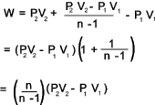
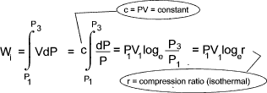

The theoretical work done on the air per cycle is the area enclosed by [ a-1-2-b- a ] which equals
The ideal compression requiring the minimum amount of work is the perfect
reversible isothermal compression process which obeys Boyle's law PV = c. This is
represented by 1-3. The work saved per cycle is [ 1-2-3-1 ]. If the compression was
isothermal the work done per cycle would be [ a-1-3-b-a ] which is
The compressor isothermal efficiency is a measure of the departure from the ideal compression process and is defined as

Slide 10
(b) Based on number of stages:
Compressors can be single stage or multistage. Normally maximum compression ratio of 5 is realized in single stage compressors. For compression ratio more than 5 the multistage compressors are used.
Type values of maximum delivery pressures generally available from different type of compressor are,
Single stage Compressor, for delivery pressure up to 5 bar.
Two stage Compressor, for delivery pressure between 5 to 35 bar
Three stage Compressor, for delivery pressure between 35 to 85 bar.
Four stage compressor, for delivery pressure more than 85 bar
(c) Based on Capacity of compressors :
Low capacity compressors, having air delivery capacity of 0.15 m3/s or less
Medium capacity compressors, having air delivery capacity between 0.15 to 5 m3/s.
High capacity compressors, having air delivery capacity more than 5 m3/s
(d) Based on highest pressure developed:
Depending upon the maximum pressure available from compressor they can be classified as:
Low pressure compressor, having maximum pressure up to 1 bar
Medium pressure compressor, having maximum pressure from 1 bar to 8 bar
High pressure compressor, having maximum pressure from 8 to 10 bar
Super high pressure compressor, having maximum pressure more than 10 bar.

Slide 11
Non-positive displacement compressors
Also called as steady flow compressors use dynamic action of solid boundary for realizing pressure rise.
Here fluid is not contained in definite volume and subsequent volume reduction does not occur as in case of positive displacement compressors.
Non-positive displacement compressor may be of ‘centrifugal type’ or ‘axial flow type’ depending upon type of flow in compressor

Slide 12
Centrifugal compressor
Centrifugal compressors, sometimes referred to as radial compressors, are a special class of radial-flow work-absorbing turbomachinery that include pumps, fans, blowers and compressors.
In an idealized sense, the dynamic compressor achieves a pressure rise by adding kinetic-energy/velocity to a continuous flow of fluid through the rotor or impeller.
This kinetic energy is then converted to an increase in static pressure by slowing the flow through a diffuser.

Slide 13
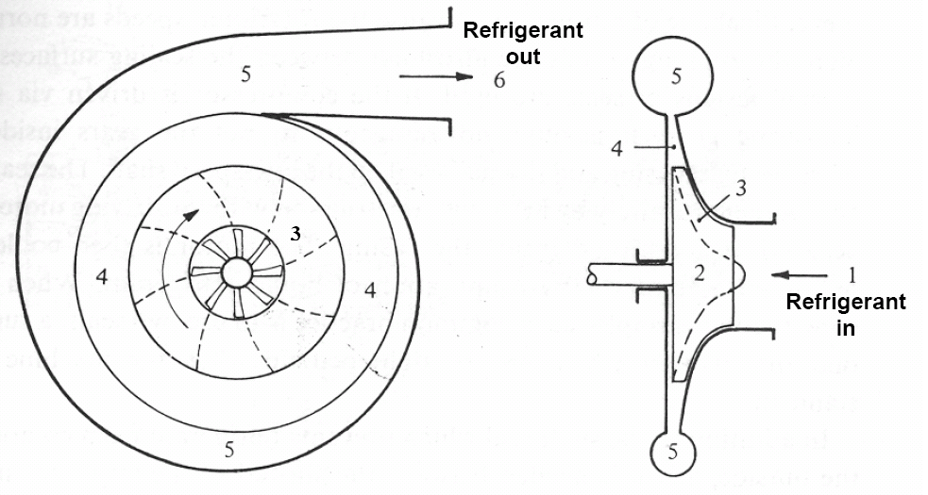


Slide 14
Centrifugal compressors are used throughout industry because they have fewer rubbing parts, are relatively energy efficient, and give higher airflow than a similarly sized reciprocating compressor (i.e. positive-displacement).
Their primary drawback is that they cannot achieve the high compression ratio of reciprocating compressors without multiple stages. Centrifugal fan/blowers are more suited to continuous-duty applications such as ventilation fans, air movers, cooling units, and other uses that require high volume with little or no pressure increase.
In contrast, multi-stage reciprocating compressors often achieve discharge pressures of 55 to 69 MPa.
Additionally for aircraft gas-turbines; centrifugal flow compressors offer the advantages of simplicity of manufacture and relatively low cost.
This is due to requiring fewer stages to achieve the same pressure rise. The fundamental reason for this stems from a centrifugal compressor's large change in radius (relative to a multi-stage axial compressor); it is the change in radius that allows the centrifugal compressor to generate large increases in fluid energy over a short axial distance.

Slide 15
Axial Flow Compressor
Axial compressors are rotating, airfoil based compressors in which the working fluid principally flows parallel to the axis of rotation.
This is in contrast with other rotating compressors such as centrifugal, axi-centrifugal and mixed-flow compressors where the air may enter axially but will have a significant radial component on exit.
Require several rows of airfoils to achieve large pressure rises making them complex and expensive relative to other designs (e.g. centrifugal compressor).
Axial compressors are widely used in gas turbines, such as jet engines, high speed ship engines, and small scale power stations. They are also used in industrial applications such as large volume air separation plants, blast furnace air, and propane dehydrogenation.
Axial compressors, known as superchargers, have also been used to boost the power of automotive reciprocating engines by compressing the intake air, though these are very rare.

Slide 16
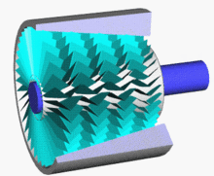
Axial Flow Compressor

Slide 17
Axial Compressor- Working
Axial compressors consist of rotating and stationary components.
A shaft drives a central drum, retained by bearings, which has a number of annular airfoil rows attached. These rotate between a similar number of stationary airfoil rows attached to a stationary tubular casing.
The rows alternate between the rotating airfoils (rotors) and stationary airfoils (stators), with the rotors imparting kinetic energy into the fluid, and the stators converting the increased rotational kinetic energy into static pressure through diffusion.
A pair of rotating and stationary airfoils is called a stage.
The cross-sectional area between rotor drum and casing is reduced in the flow direction to maintain axial velocity as the fluid is compressed.
In short, the rotor increases the absolute velocity of the fluid and the stator converts this into pressure rise.

Slide 18
Applications
A partial list of centrifugal compressor applications include:
In pipeline transport of natural gas to move the gas from the production site to the consumer.
In oil refineries, natural gas processing plants, petrochemical and chemical plants.
In air separation plants to manufacture purified end product gases.
In refrigeration and air conditioner equipment refrigerant cycles.
In industry and manufacturing to supply compressed air for all types of pneumatic tools.
In gas turbines and auxiliary power units.
In pressurized aircraft to provide atmospheric pressure at high altitudes.
In automotive engine and diesel engine turbochargers and superchargers.
In oil field re-injection of high pressure natural gas to improve oil recovery.

